Slide 1

Data Analysis Project
IST 687

Slide 2
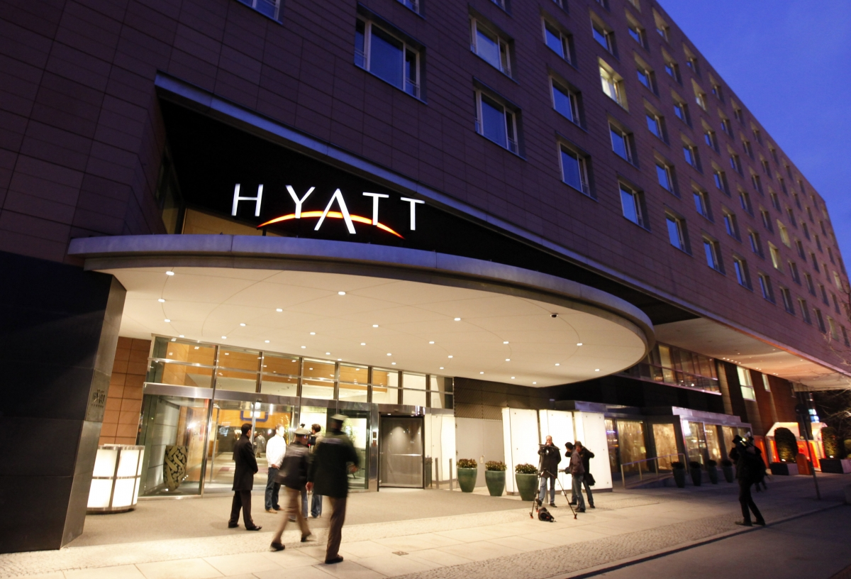
Project Description
• Hyatt Hotels decided to perform an extensive consumer survey that occurred from February 2014 until January 2015.
• Survey reflected several different categories including personal customer data, ratings of hotel personnel, hotel services, hotel amenities and geographical hotel locations.
• Our group was tasked with coming up with recommendations for Hyatt to better improve NPS scores.

Slide 3
Presentation Schedule
Business Questions
Decision Making & Analyze Data
Visualizations/Descriptive Stats
Recommendations

Slide 4
Business Questions
?
Business Question #1: Which hotel services variables impact a “Business” customers’ stay?
Business Question #2: Which hotel services variables impact a “Leisure” customers’ stay?
Business Question #3: What state in the United States would be best to look at given their number of detractors and total number of respondents?
Business Question #4: Is the purpose of the respondents’ visit a direct indicator on their NPS scores?
Notes:
May require more than one slide

Slide 5

Assumptions
Assumption 1: Everyone who took the survey completed it with honesty and integrity.
Assumption 2: It is possible to enhance the experience of detractors and passives to change them to promoters overtime.
Assumption 3: Analyzing four out of twelve months of data will give us enough information to provide solutions to the hotel’s business practices.
Assumption 4: It is not possible to change the human variability of people staying in a given hotel, it is only possible to change the services and amenities of a given location.
Assumption 5: The categorical variables can be objectively used by people staying for either leisure or business or can be apparent in both.

Slide 6

Data Selection
Group decided to look at survey data from 4 out of the 12 months of year
We wanted to select a month from each season
From here we determined the location and brand of Hyatt we wanted to look at

Slide 7
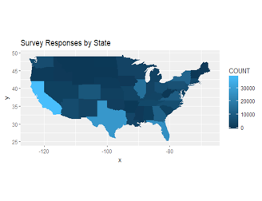
Location Selection: California
The to the right shows a total count of survey respondents in the US.
We decided to use california because they had the greatest response amount.

Slide 8
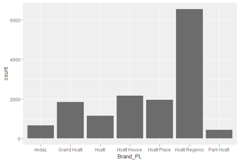
Hyatt Brand Selection: Hyatt Regency
Bar Graph shows the greatest number of respondents in the survey came from those staying in Hyatt Regencys.
Notes:
May require more than one slide

Slide 9
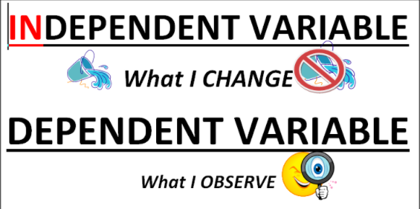
Linear Models
In simplest terms we used a data science technique that allowed us to see what Independent variables were affecting the dependent variable or (likelihood to recommend).
Independent Variables we looked at were intern, customer service, check-in rating, hotel condition, tranquility, staff cared.
Essentially, our findings saw that the following variables had a significant effect on the customer’s likelihood to recommend.

Slide 10
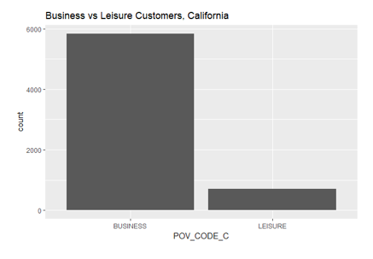
Purpose of Stay Distribution
Graph to the right shows a distribution of business vs leisure customers in California.
We saw that a large majority of customers were staying at the Hyatt Regency for Business purposes.

Slide 11
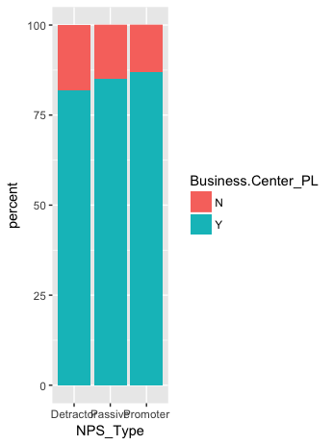
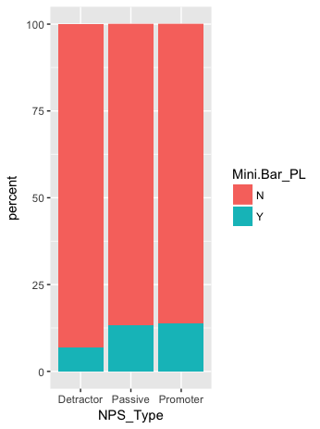
A-Rules
We wanted to look at events that could happen given our knowledge of something else that has happened
Looked at variables such as minibars, business centers, etc and whether or not they were apparent given certain situations
From here we were able to find the probability of someone being detractor

Slide 12
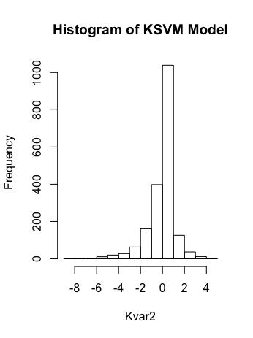
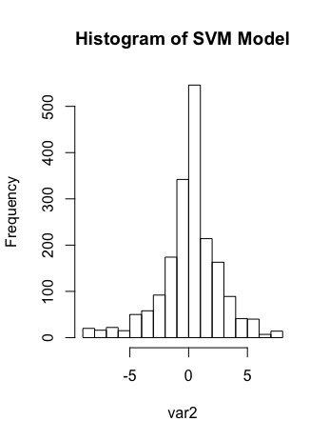
KSVM/SVM
Predictions of our dependent variables
For us we looked at NPS_Type
These model looks at all of the data
15.9% error

Slide 13
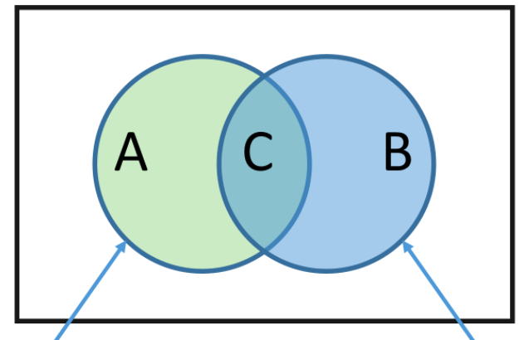
Naive Bayes
Predict NPS Type given a set of variables
Hotel condition, tranquility, staff cared, check in number, internet satisfaction, convention center, business center, spa, mini bar and customer service
22.3% Error which we were happy with and supports our findings.

Slide 14

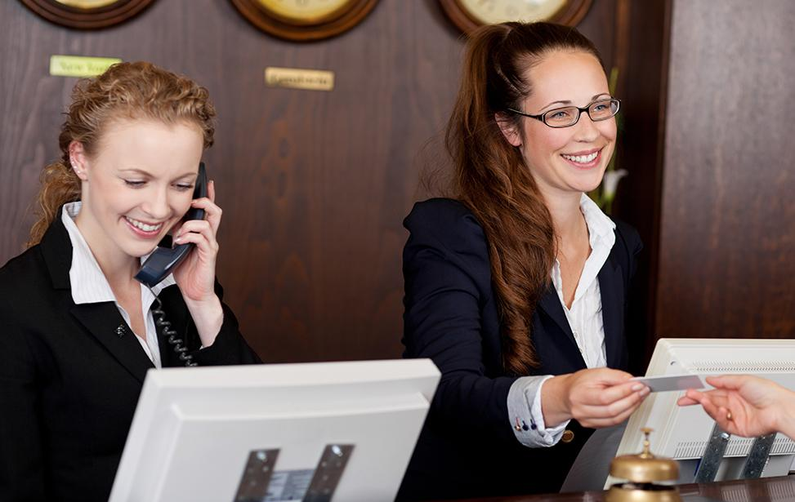
Recommendations
Recommendation #1: Improve Hotel Customer Service. Maybe hire more customer service representatives to ensure speed and quality.
Recommendation #2: Improve the condition of the hotels. Hotel condition was seen as important on customer’s likelihood to recommend. Ensure hotels are clean and up to date.
Recommendation #3: Ensure things like mini-bars are available and up to good condition. One thing Hyatt could do is a increase the supply of drinks in each mini-bar
Recommendation #4 Make sure business centers are available in the hotels.

Slide 15
THANK YOU!

